Slide 1
Devops: What is that, Anyway?
By: Laura Stone

Slide 2

Who am I?
“Cloud DevOps Engineer”
Background in QA
Background in Operations
Twitter: @tyrostone
GitHub: laura-stone
Notes:
Unusual career trajectory:
AmeriCorps after graduating
Human Services briefly
Return to what I enjoyed in high school – computers
Got temp job in QA
Company liked me and hired me full time
Began to learn Python on my own via online classes
Background in QA:
Manual testing
Automated smoke and UAT with Selenium (Python) – GUI testing
Background in Operations:
Linux
Puppet management
AWS infrastructure management
Python scripting (boto)

Slide 3
What’s the Agenda?
DevOps Confusion
History of DevOps
Definitions
How to DevOps
DevOps with Python
Further resources
Questions
Notes:
Unusual career trajectory:
AmeriCorps after graduating
Human Services briefly
Return to what I enjoyed in high school - computers
Background in QA:
Manual testing
Automated smoke and UAT with Selenium (Python) – GUI testing
Background in Operations:
Linux
Puppet management
AWS infrastructure management
Python scripting (boto)

Slide 4
What is Devops?
Notes:
AUDIENCE PARTICIPATION: Ask people what they think DevOps is

Slide 5
What is Devops?
Ops all the things?!
Continuous integration
Agile
Operations
DevOps teams
Scale
Microservices
Development
Business growth
Reliability
Automation
Lean
DevOps tools
Synergy
Moving faster
Silos
Notes:
So what is DevOps?
Let’s start by looking at what people SAY when they are talking about DevOps:
Is it Agile?
Is it that we need DevOps teams?
Or DevOps tools?
Is it an outgrowth of Lean?
From an operations perspective:
Is it about ensuring application scale and reliability?
Or is it about moving faster?
Is it about the ChatOps? BeerOps? HugOps?? Is it Ops all the things??? Ops none of the things?
From a development perspective:
Where does automation fit into all of this?
Oh yeah, and I heard something about continuous integration?
Is it simply smooshing Development and Operations together?
Or is it about the business?
Align cross-organizational silos to generate synergy??
Or just eliminate these silos altogether?

Slide 6
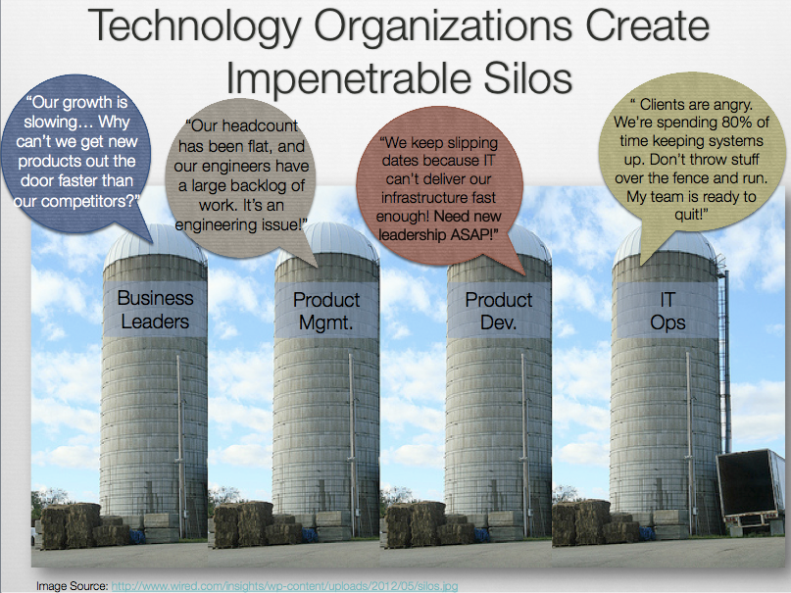
Notes:
Maybe you’ve seen a picture like this:

Slide 7
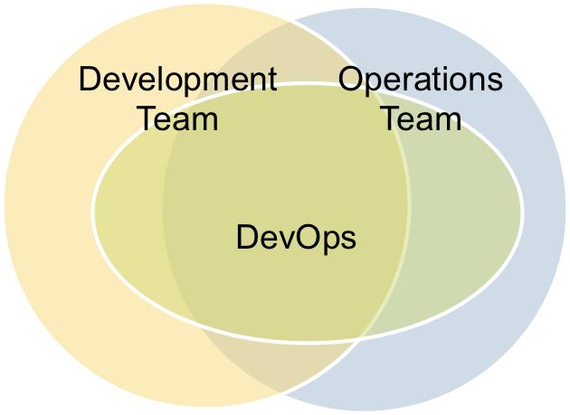
Notes:
Or like this one:
Reference: https://media.licdn.com/mpr/mpr/p/8/005/080/3f1/0eefaa1.jpg

Slide 8

Notes:
Hopefully that hasn’t made your head spin too much, and if you don’t understand everything that’s been said so far, or have questions about terminology or WTF I’m talking about…that’s okay! I’ll address a lot of this confusion going forward.
So. Let’s start over.

Slide 9
What is Devops?

Slide 10
Devops is…

Slide 11
#DevOps(Days)
Notes:
DevOps is a hashtag:
It emerged from the first DevOpsDays unconference, which was held in Ghent in 2009 (Ghent is in Belgium…do not feel bad if you did not know this, I had to look it up)
Organized by Patrick Debois
Outgrowth of the idea of “Agile Infrastructure/Agile System Administration”
Centered around how to facilitate cooperation between operations engineers/sysadmins and developers
Conference was 1 day event – but conversation continued on Twitter
“Days” portion of hashtag dropped because 150 char limit = precious real estate
In 2011, Gartner picked up the term and forecasted that it would be a mainstream strategy employed by enterprise companies
And the fighting for thought leadership began
Still, DevOps is ground-up movement (by engineers, for engineers)
DevOps is an experience-based movement
Sharing what works, what doesn’t work, collaborating to make themselves better
Decentralized
DevOpsDays unconferences have taken off
14 unconferences in 2015 so far, across 3 continents and 6 countries
Another 8 unconferences this year
Short History of DevOps video: https://www.youtube.com/watch?v=o7-IuYS0iSE
DevOpsDays website: http://www.devopsdays.org/

Slide 12
Devops: The Definition*
“a cross-disciplinary movement dedicated to the praxis of building and delivering quality systems in order to solve business problems and provide value to customers”
*sort of
Notes:
http://theagileadmin.com/what-is-devops/ - Jezz Humble
https://www.youtube.com/watch?v=_DEToXsgrPc – Chef Style DevOps Kung Fu – Adam Jacob

Slide 13
But… What does That Mean?

Slide 14
Cross-disciplinary
“a cross-disciplinary movement dedicated to the praxis of building and delivering quality systems in order to solve business problems and provide value to customers”
Notes:
Cross-disciplinary
“Dev” – Development – ANYONE involved in developing the product
- Software Engineers
- Product management
- QA
- UX Folks
“Ops” – Operations – blanket term for:
- Systems Engineers
- System Administrators
- Release Engineers
- Database Engineers
- Security professionals (analysts, etc.)
“a cross-disciplinary movement dedicated to the praxis of building and delivering quality systems in order to solve business problems and provide value to customers”

Slide 15
Movement
“a cross-disciplinary movement dedicated to the praxis of building and delivering quality systems in order to solve business problems and provide value to customers”
Notes:
Movement
NOT A TOOL
NOT A JOB TITLE
NOT “EVERYTHING”
NOT REALLY A “THING YOU DO”*
“a cross-disciplinary movement dedicated to the praxis of building and delivering quality systems in order to solve business problems and provide value to customers”

Slide 16
PRAxis
“a cross-disciplinary movement dedicated to the praxis of building and delivering quality systems in order to solve business problems and provide value to customers”
Notes:
Praxis – putting theory into practice
https://afeministtheorydictionary.wordpress.com/2007/07/02/praxis/
Luke Kaines (CEO of PuppetLabs) – “DevOps is still mostly theory”
“a cross-disciplinary movement dedicated to the praxis of building and delivering quality systems in order to solve business problems and provide value to customers”

Slide 17
Solve business problems
Deliver value to customers
Notes:
Align different sections of organization around what really matters:
1. Your customers
2. The bottom line
These two things are very similar but slightly different

Slide 18
How To Devops

Slide 19
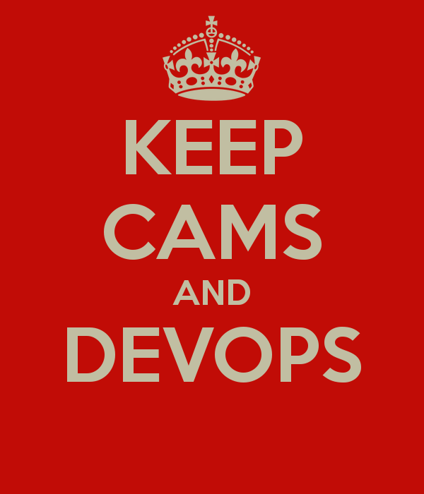
How to devops
CAMS
Culture
Automation
Measurement
Sharing
Etc.
Notes:
CAMS
Acronym describing one version of DevOps methodology
Coined by John Willis and Damon Edwards in 2010 at first DevOpsDays US (Mountain View, CA)
Many variations:
CALMS (adding Lean specifically)
CALMSS (adding Lean and Sourcing Strategy)
Other methodologies similar to CAMS:
Gene Kim’s Three Ways
Chef Style DevOps Kung Fu
Reference: http://sd.keepcalm-o-matic.co.uk/i/keep-cams-and-devops.png
http://devops.com/2015/05/13/surprise-broad-agreement-on-the-definition-of-devops/

Slide 20
Let’s Come back to this…
Learning
Culture
Collaboration
Empathy
Breaking down silos
Diversity
Teamwork
Experimentation
Communication
Notes:
CULTURE IS HARDEST PART TO DEFINE
ITS ALSO THE MOST IMPORTANT
GENERAL IDEA IS…(next slide)

Slide 21
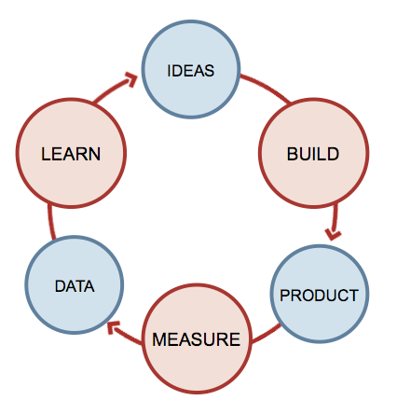

Notes:
The Lean Startup

Slide 22
People
Processes
tools
Notes:
Also known as people over products over companies

Slide 23
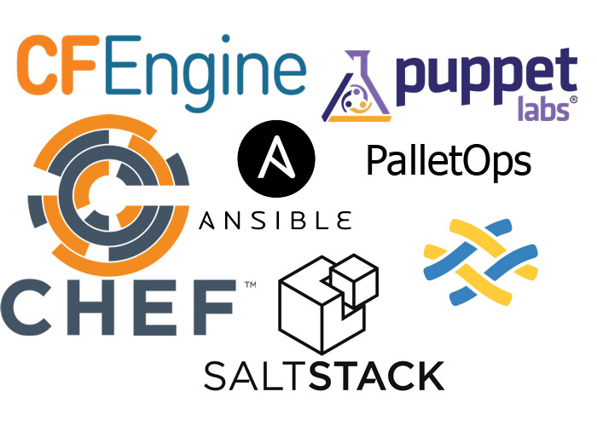
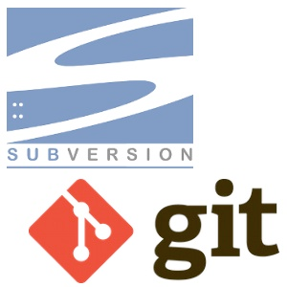
automation
Continuous Delivery
Infrastructure as code
Version control
Value stream mapping
Notes:
Automate everything possible
Continuous delivery vs continuous integration
(Build, test, deploy, release)
Idempotence
Reference: https://www.getfilecloud.com/blog/wp-content/uploads/2014/07/CMTs1.jpg
Reference: http://wpforce.com/media/wordpress-version-control.jpg

Slide 24
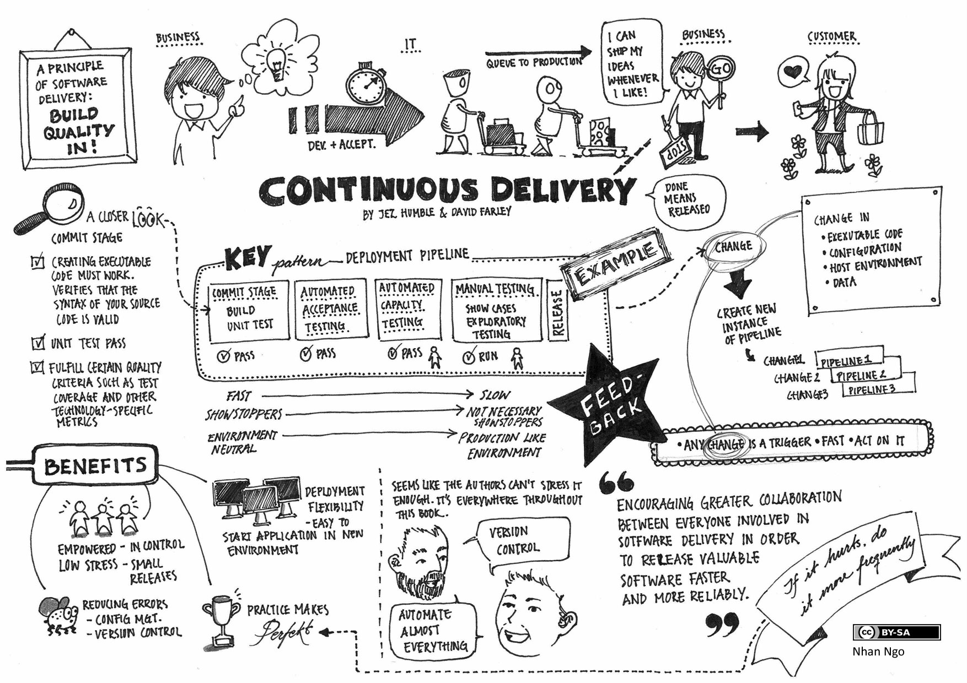
Notes:
http://continuousdelivery.com/2014/02/visualizations-of-continuous-delivery/
Nhan Ngo – QA Engineer at Spotify

Slide 25

Measurement
Why? How?
- Expect failure!
- Failure as learning opportunity!
- Continuous improvement!
- Logging
- Monitoring - Alerting - Anonymous Surveys - Retrospectives
Notes:
Several important things to note:
Point is to amplify feedback loops (like continuous delivery)
Importance of key metrics
Key metrics will change over time
Reference: http://images.clipartpanda.com/12-inch-ruler-printable-8710_ruler-teal_pp.png

Slide 26
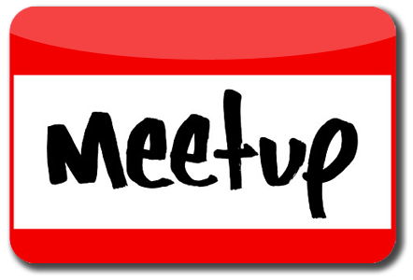
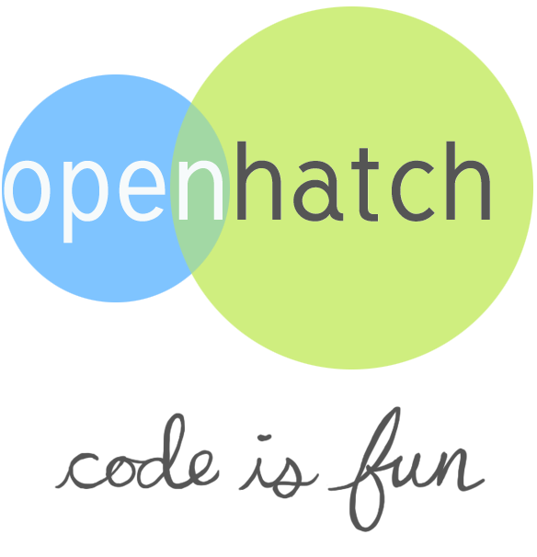
Sharing
Learning Lunches
Hackathons
Open Source
Meetups
Boston Devops
Boston Amazon Web Services
Boston Infrastructure Coders
Ansible Boston
Conferences
DevOpsDays Boston
Notes:
Reference: https://upload.wikimedia.org/wikipedia/commons/7/73/Meetup_Logo_2015.png
Reference: http://iub.openhatch.org/imgs/Code_is_fun.png

Slide 27
How To Devops (Python Style)

Slide 28
IT DEPENDS

Slide 29
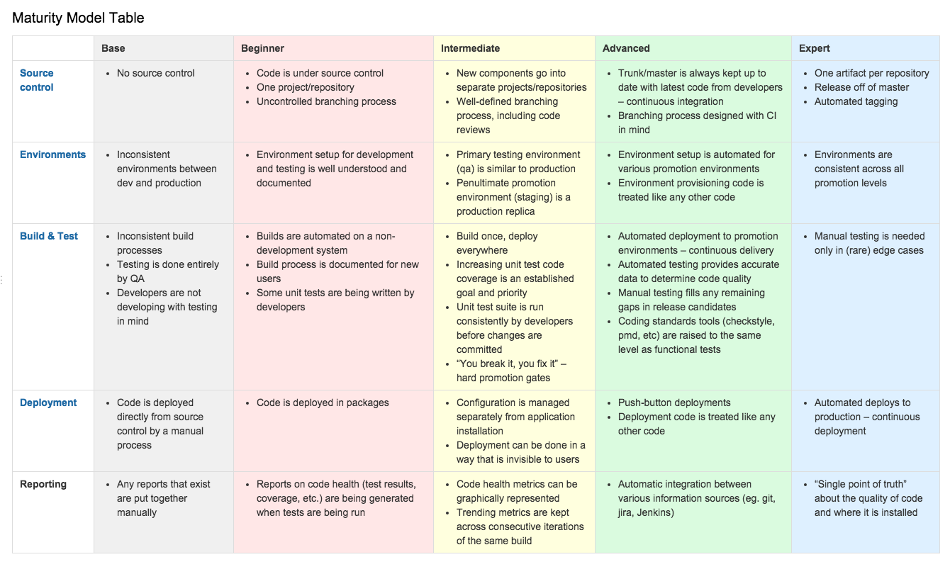

Slide 30
DEMO

Slide 31
Python for Great Devops Good
Deployment
Fabric
Provisioning
Boto (AWS)
Troposphere
Configuration Management
Ansible
Salt(Stack)
Continuous Integration
Buildbot
Monitoring
AmonOne
ServerDensity
Glances
Etc.
https://wiki.python.org/moin/ConfigurationAndBuildTools
Notes:
Fabric – SSH client running in a loop
Boto – Python library to interact with AWS (interface)
Troposphere – Python library for creating AWS CloudFormation templates
Ansible – configuration management and deployment tool written in Python (you write YAML)
Salt(Stack) – same as Ansible

Slide 32
Resources
Books
The Lean Startup – Eric Ries
The Phoenix Project - Gene Kim, Kevin Behr, George Spafford
The Goal - Eliyahu M. Goldratt, Jeff Cox
Continuous Delivery – Jez Humble
Web Operations – John Allspaw
Notes:
Resources

Slide 33
Resources
Videos
Chef Style DevOps Kung Fu
10+ Deploys Per Day: Dev and Ops Cooperation at Flickr
The (Short) History of DevOps
Continuously Deploying Culture
Notes:
Resources

Slide 34
Resources
Tutorials/Online Resources
Full Stack Python
How to Containerize Python Applications
Infrastructure with Python
Udacity - Intro to DevOps
DevOps: A Crash Course
Notes:
Resources

Slide 35
“CULTURE”
Notes:
Go back to idea of culture
Very male dominated space (most of tech is, this particularly so)
PuppetLabs State of DevOps Report 2015

Slide 36
Questions?

Slide 37
Twitter: @tyrostone
GitHub: laura-stone
laura.stone@alumni.carleton.edu

